Slide 1
Conversation Cloud
User Experience Final Presentation
Abidaan Nagawkar | Anand Purohit | Nikhil Raina | Vipul Kashyap | Zeal Ganatra

Slide 2
The Problem
The problem here can be divided into two categories:
One is to represent a conversation in succinct way, that helps the people involved in the conversation to recall it.
The other dimension here is to provide a summary for others to understand.
We are mainly focussing on the recall

Slide 3
Approach
Initial Client Meeting - Understanding the problem, clarifying expectations.
Sketches - Visualizations of a sample conversation, how not to represent a conversation.
Research - Literature review on the best ways to represent conversations.
First Prototype - Initial design, representing one conversation.
Client Feedback - Focus on the big picture, holistic perspective.
Refinement - Search functionality, different types of conversations.
Evaluation - User feedback.

Slide 4
Approach Cont.
Our main focus was to search for different ways to represent a conversation. The few areas we dwelled on were:
Using images(generated by the system)
Using videos
Using images with sounds.

Slide 5
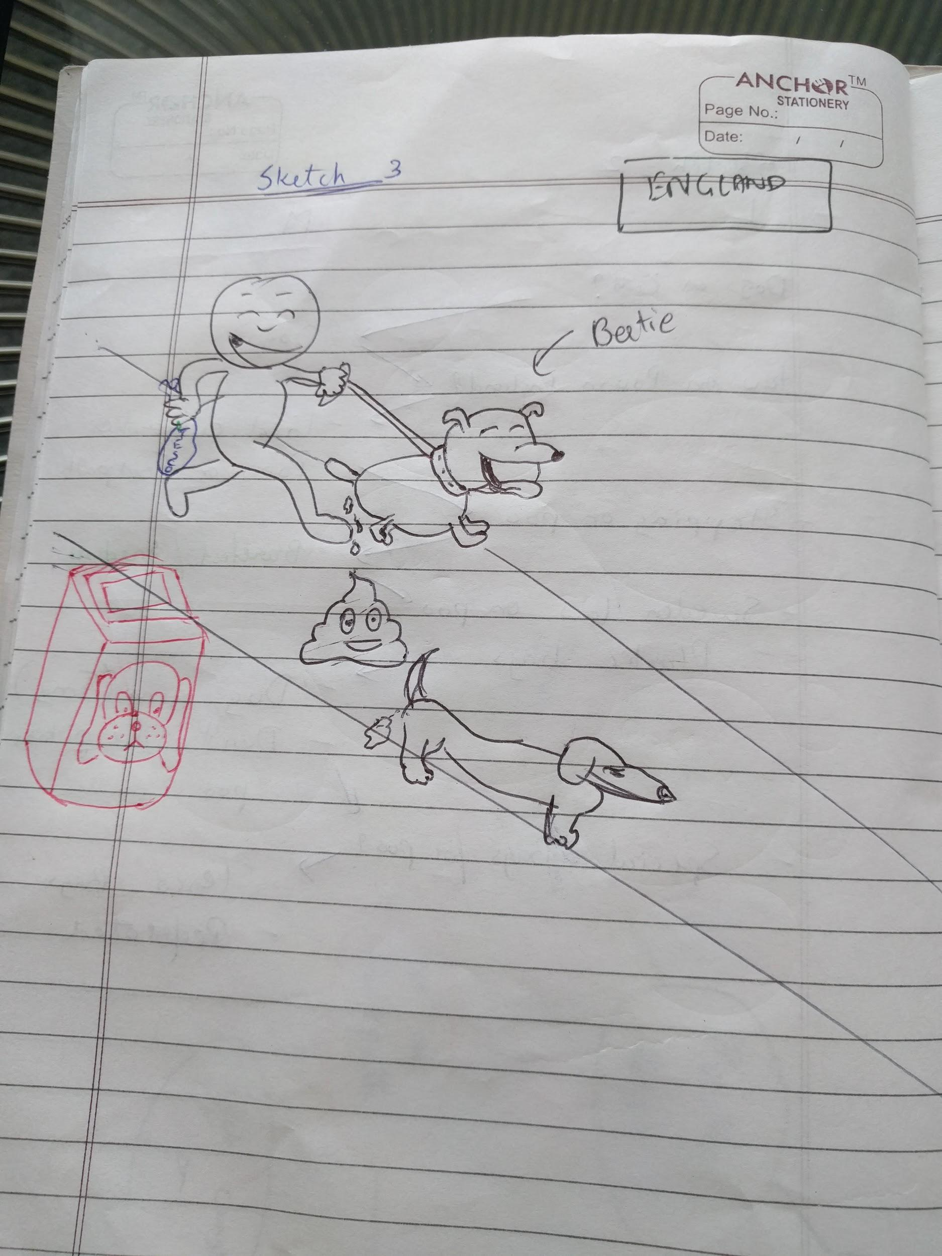
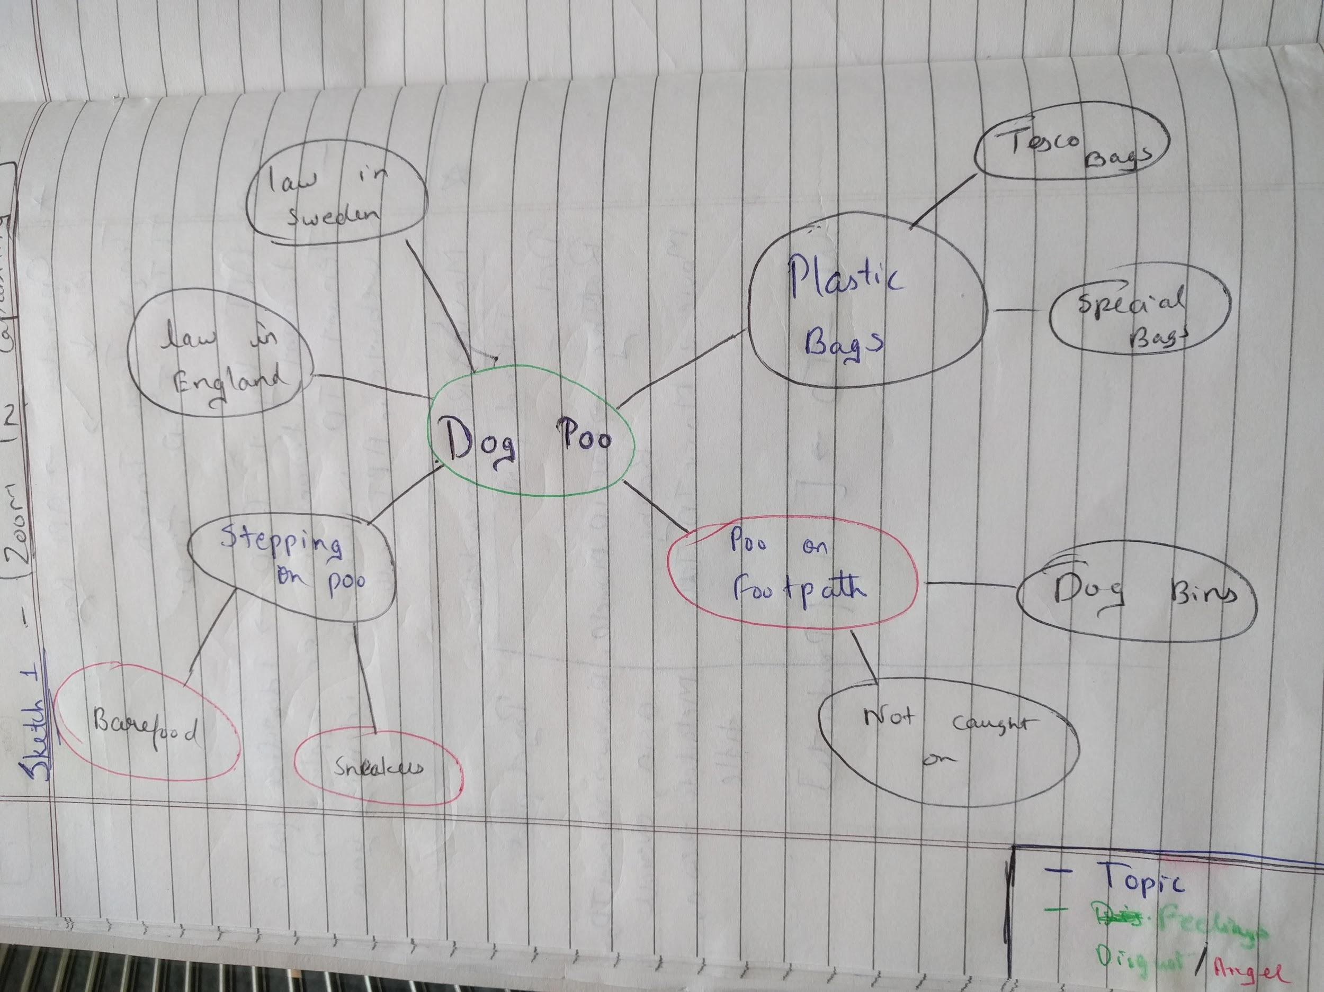
Initial Designs
Each person made 5 sketches to represent any conversation in general

Slide 6
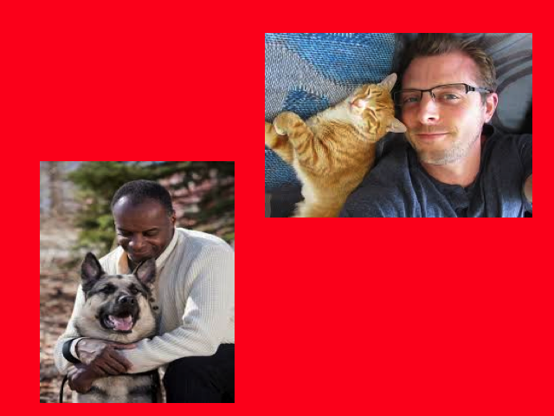
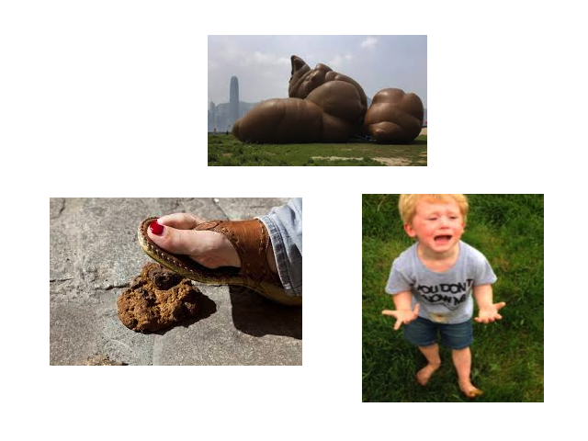
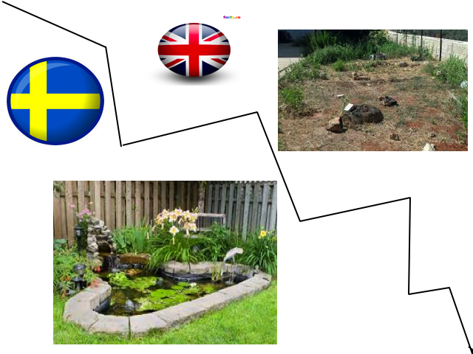
Initial Designs Cont.
Decided on a transcript
Created initial design for the transcript

Slide 7
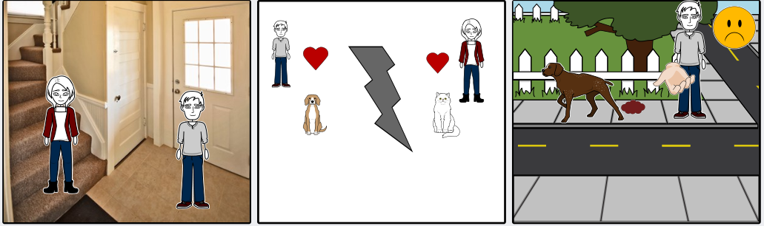
Initial Designs Cont.

Slide 8
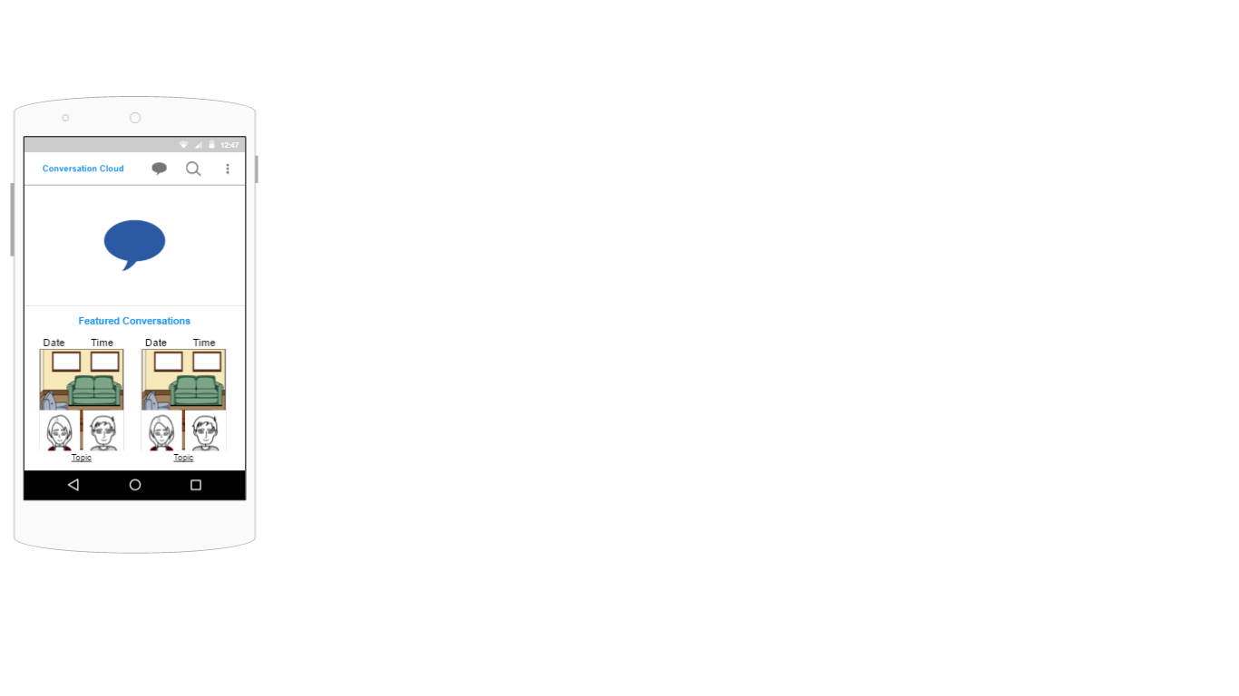
First Prototype
First Prototype using proto.io

Slide 9
Client Feedback
Need for scalability
Need to represent explicit and implicit information
Search capabilities, based on different anchors
How to represent different conversation, all the conversations are not flat. There can be multiple parallel conversations in a single conversation.

Slide 10
Refinement
Focus on ways to represent a large number of conversations.
List view vs Tile view.
Search functionality.
Representing conversations that are not sequential.
Conversations that briefly move off-topic vs conversations that move from one topic to another.

Slide 11
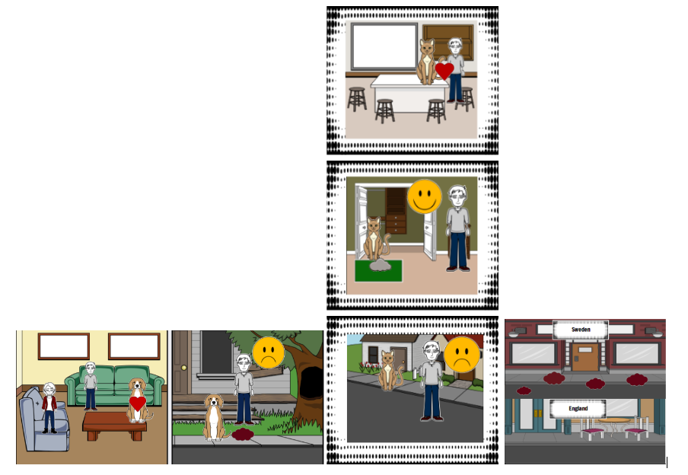
Final Prototype
Final Prototype

Slide 12
Evaluation with Control Group
Done on 6 volunteers by reading and listening
Reading: 4 volunteers - over approx 1 week.
Initially asked 3 questions to determine if they have read the conversation
Later asked 5 questions to determine their amount of recall
Listening: 2 volunteers - over 2 days
Later asked same 5 questions to determine their amount of recall

Slide 13
Evaluation with Control Group (cont..)
Deductions:
Mostly people can remember the gist and people of the conversation without having to see the “Conversation Cloud”.
People can very well recall what they see in the storyboard of “Conversation Cloud”.
Names if not mentioned in the storyboard of “Conversation Cloud” are difficult to recall.
Some people can answer questions with multiple answers only partially.
Constraints:
The less number of people taken into consideration for the study can be a constraint.
Only sequential conversations were evaluated, conversations that move off-topic were not.
Listening based evaluation was done only over a period of 2 days.
Lack of control over subjects re-reading the conversation.

Slide 14
Resources
Understanding comics by Scott McCloud
Initial Design
Transcript

